Slide 1
Lab # 1
And or Gate
Using elvis

Slide 2
Material list
Elvis Board
Misc. wires
Multisim
74LS32 Quad 2-input OR Gate
74LS08 Quad 2-input AND Gate
Excel

Slide 3
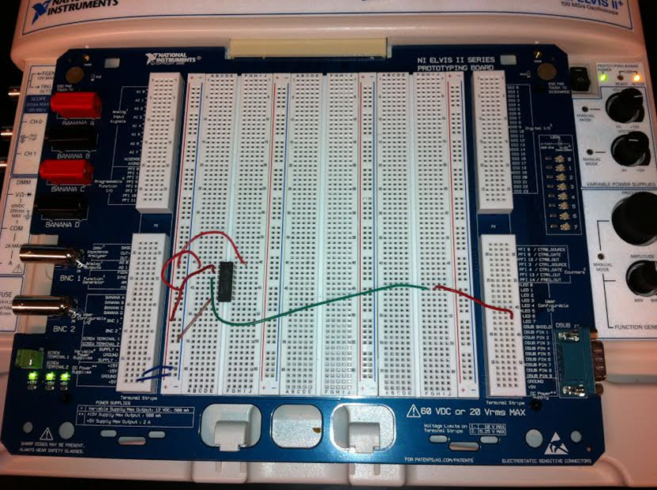
Or Gate

Slide 4
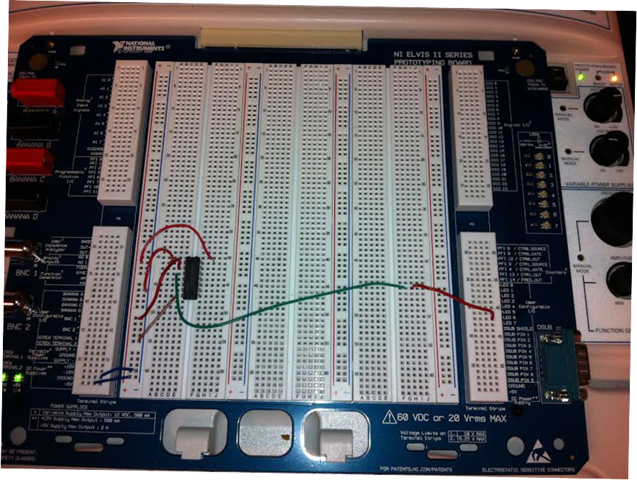
And Gate

Slide 5
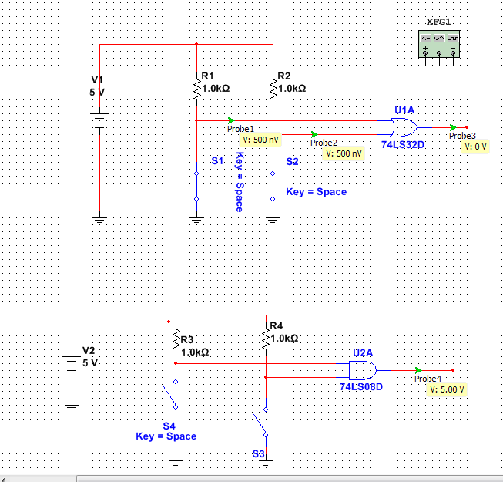
Multisim showing And/Or gates
Or Gate
5 volt power source running through 1k resistor into gates
And Gate

Slide 6
Truth table of And gate
 |  | AND
 |  |  | A | B | C
 |  | 1 | 0 | 0 | 0 | 1
 |  | 2 | 0 | 1 | 0 | 2
 |  | 3 | 1 | 0 | 0 | 3
 |  | 4 | 1 | 1 | 1 | 4

Slide 7
Truth Table of Or Gate
 |  | OR
 |  |  | A | B | C
 |  | 1 | 0 | 0 | 0 | 1
 |  | 2 | 0 | 1 | 1 | 2
 |  | 3 | 1 | 0 | 1 | 3
 |  | 4 | 1 | 1 | 1 | 4

Slide 8
Inverted
Or And Circuit using Boolean reduction lab #2

Slide 9
Materials used
Multisim
Excel
Elvis
Misc. Wires
Switch
74LS00 Quad 2-input NAND Gate
74LS04 Quad 2-input NAND Gate
74LS08 Quad 2-input AND Gate
74LS32 Quad 2-input OR Gate
Digital Multimeter

Slide 10
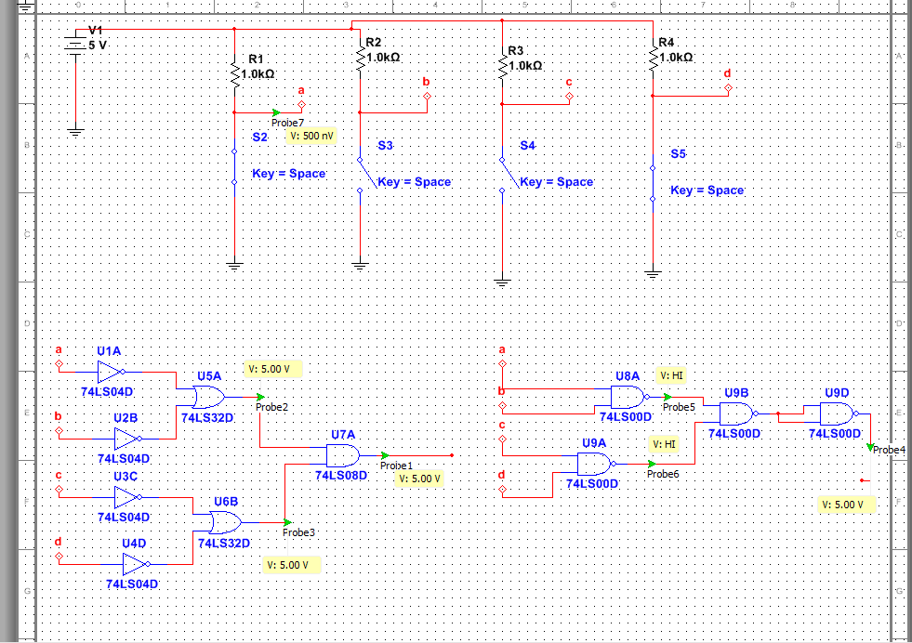
Inverted or gate using multisim
Inverter
Nand gate

Slide 11
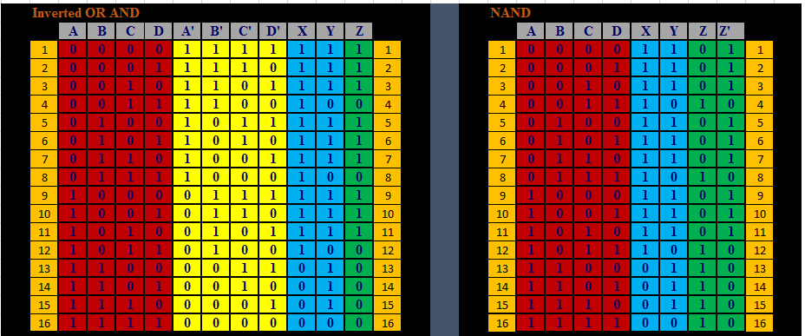
Truth table for Inverted “or”, “and” and “nand”

Slide 12
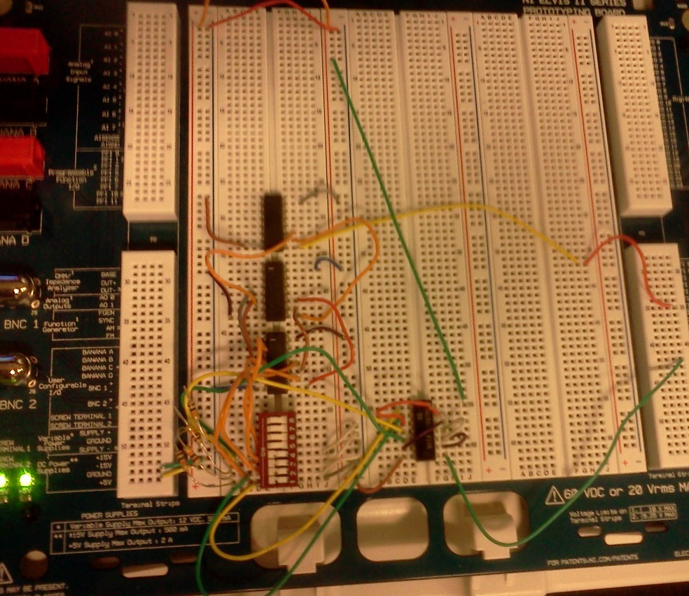
Circuit

Slide 13
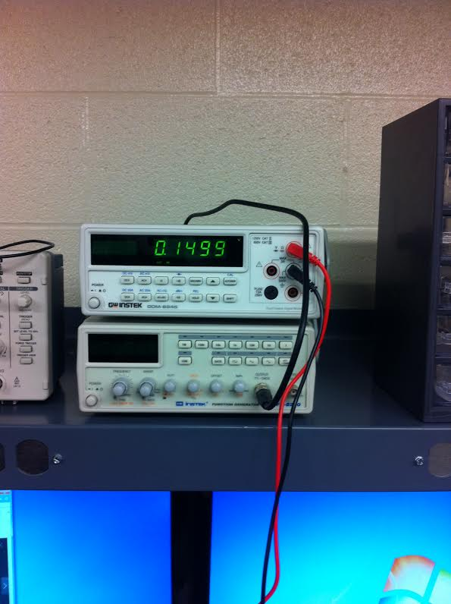
Dmm off w/led

Slide 14
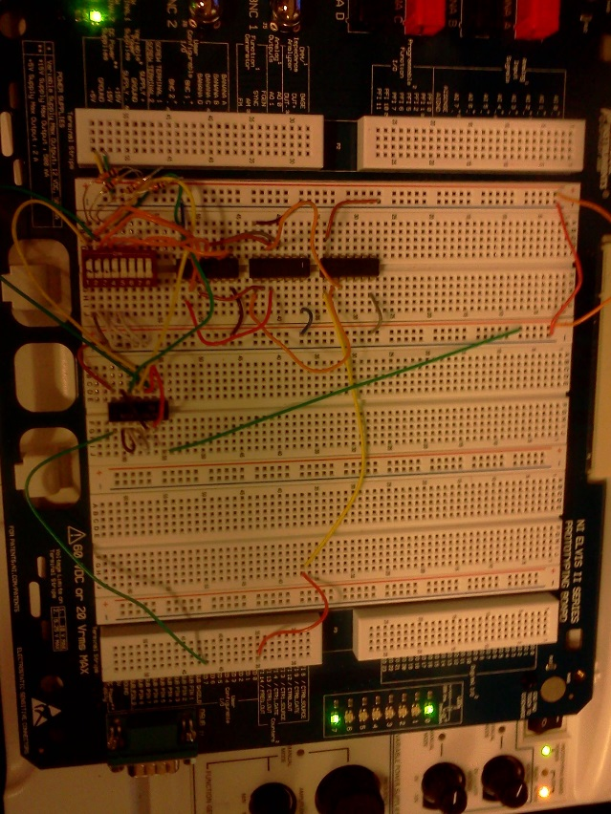
Circuit led on

Slide 15
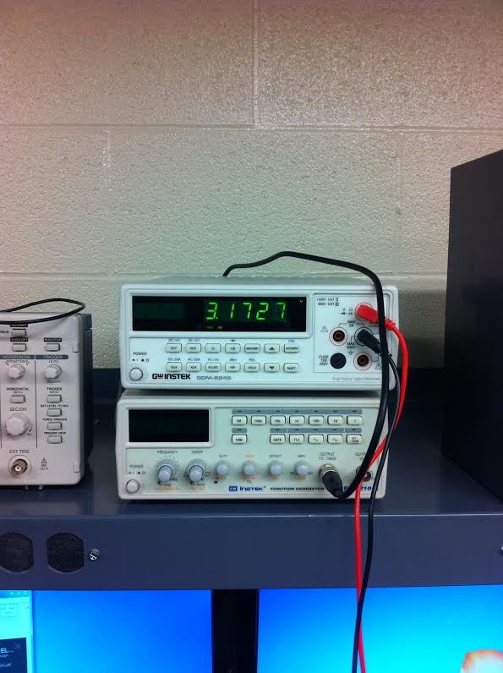
Dmm on w/led

Slide 16
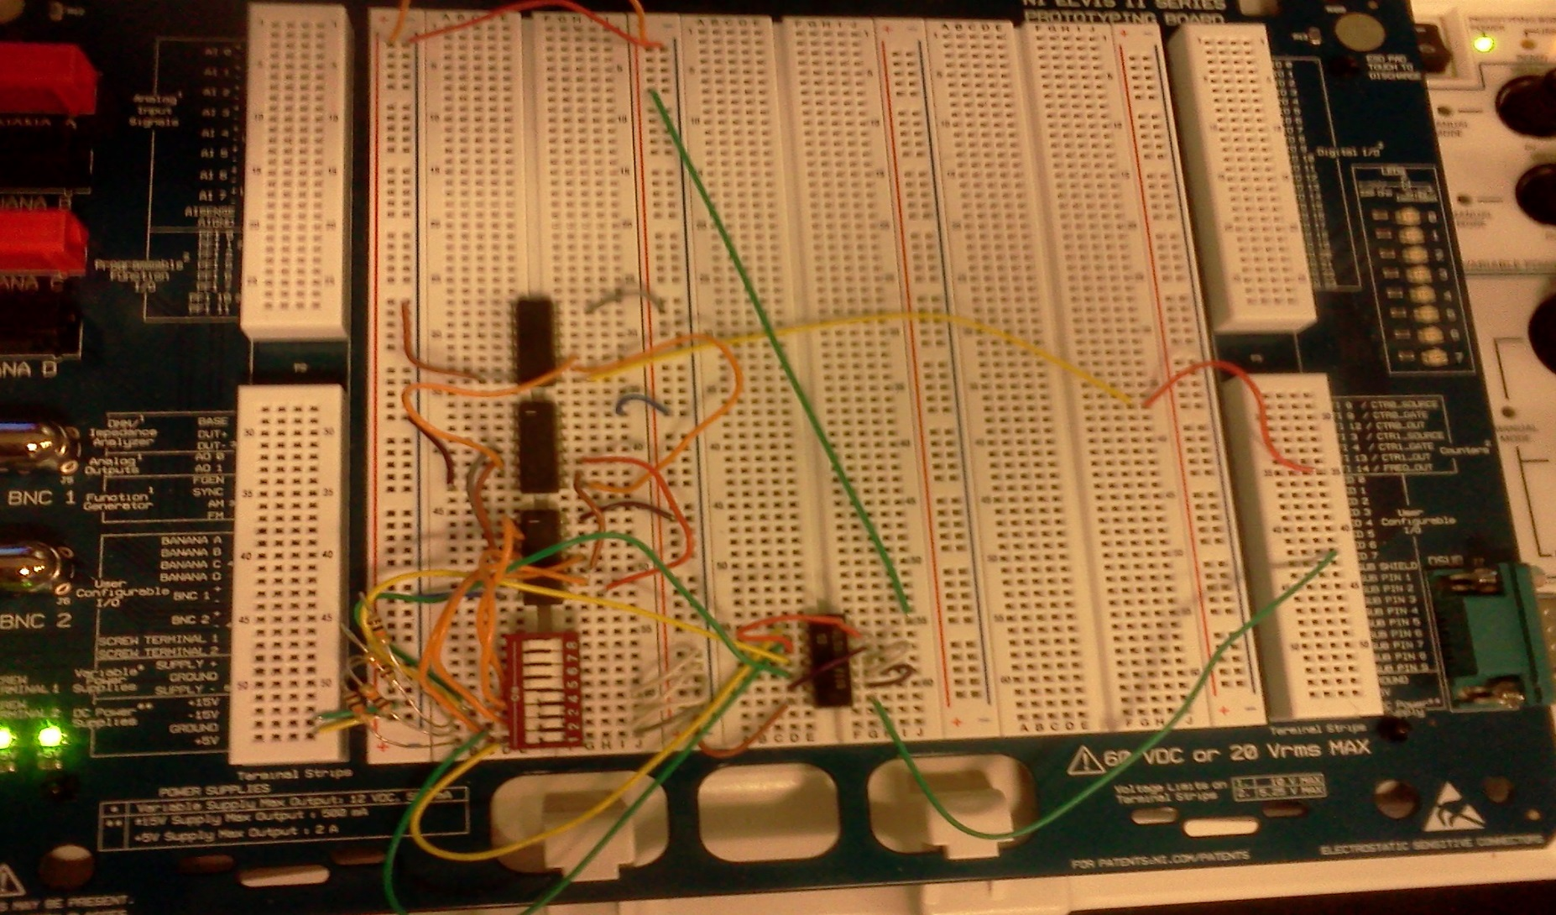
Circuit led off

Slide 17
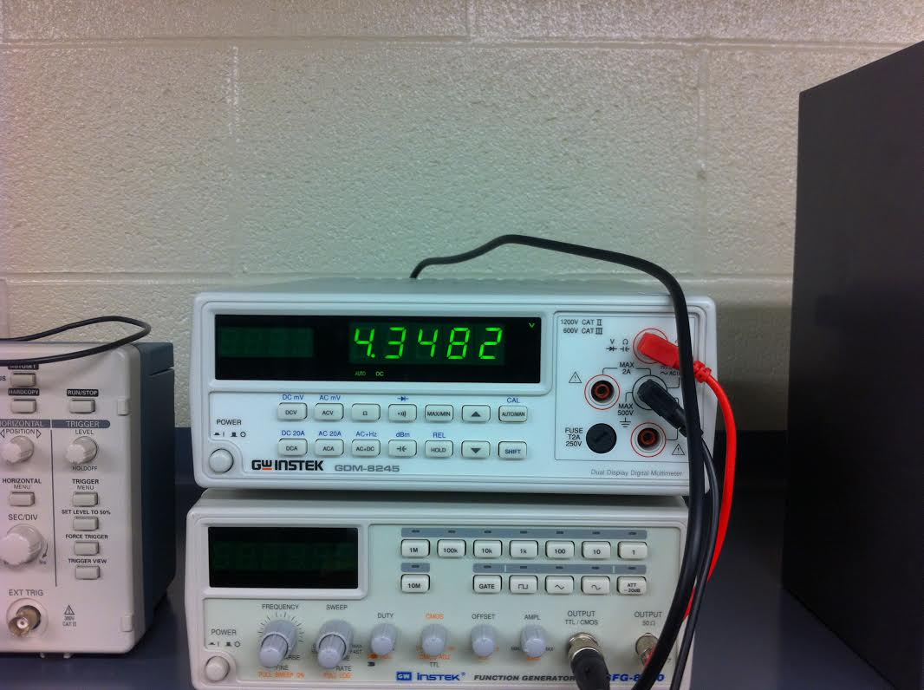
Dmm 1 w/out led

Slide 18
Midterm

Slide 19
Materials used
Multisim
Elvis
Misc. Wires
74LS08 Quad 2-input AND Gate
74LS32 Quad 2-input OR Gate
7404 Inverter
Resistor

Slide 20
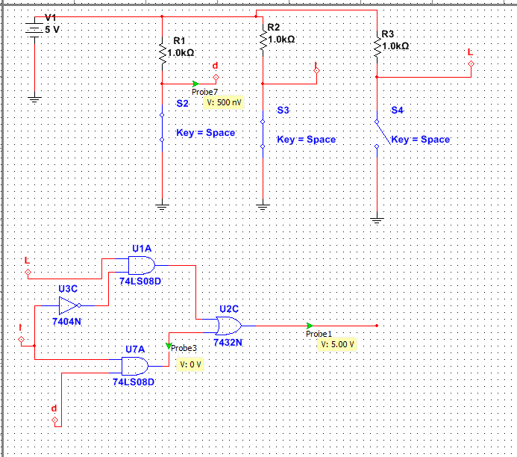
Door
Ignition
Light
Midterm - Multisim

Slide 21
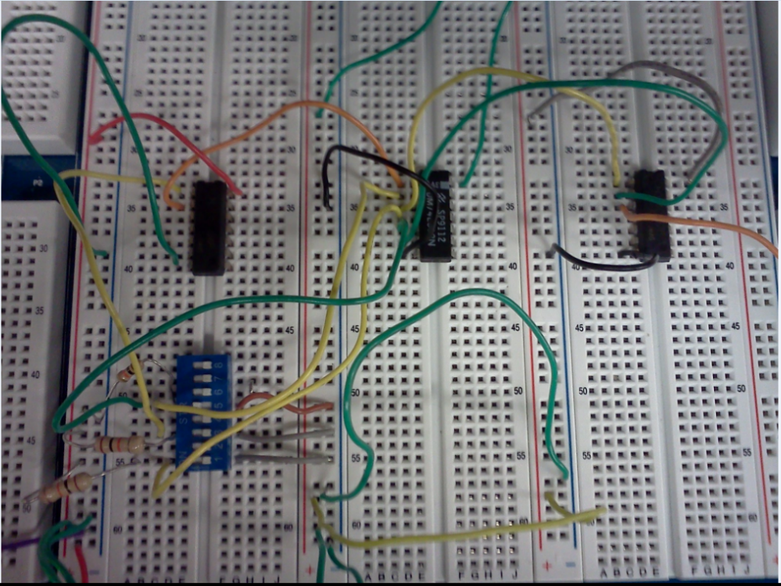
3 switch
LIGHTS
IGNITION
DOOR

Slide 22
Nand and jk flip flop – multisim lab # 4
Materials Used
Multisim

Slide 23
Nand latch

Slide 24
Jk flip flop

Slide 25
Basic stamp lab # 5

Slide 26
Materials used
Basic Stamp
Misc. Wire
Variable Resistor
LED Lights
Switch

Slide 27
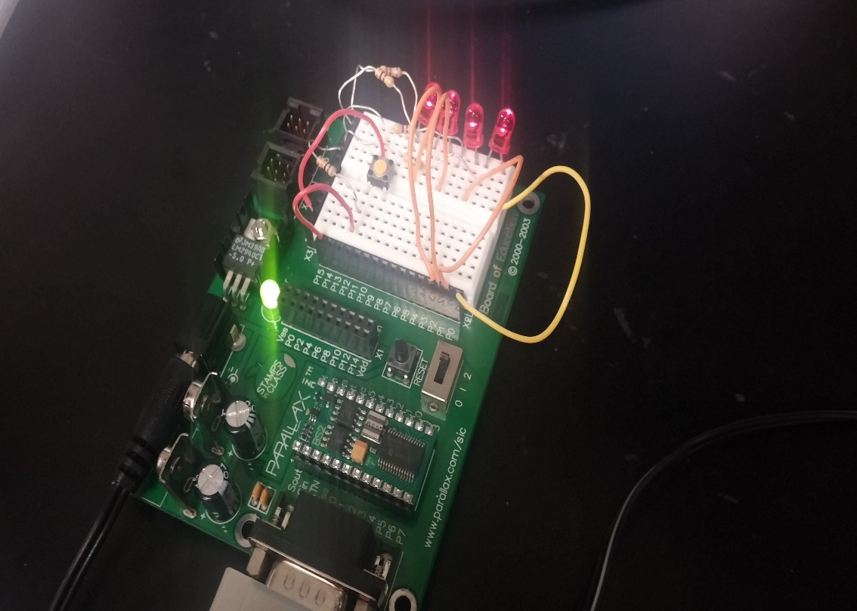
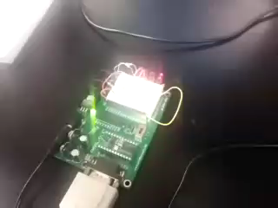
Binary counter using led’s

Slide 28
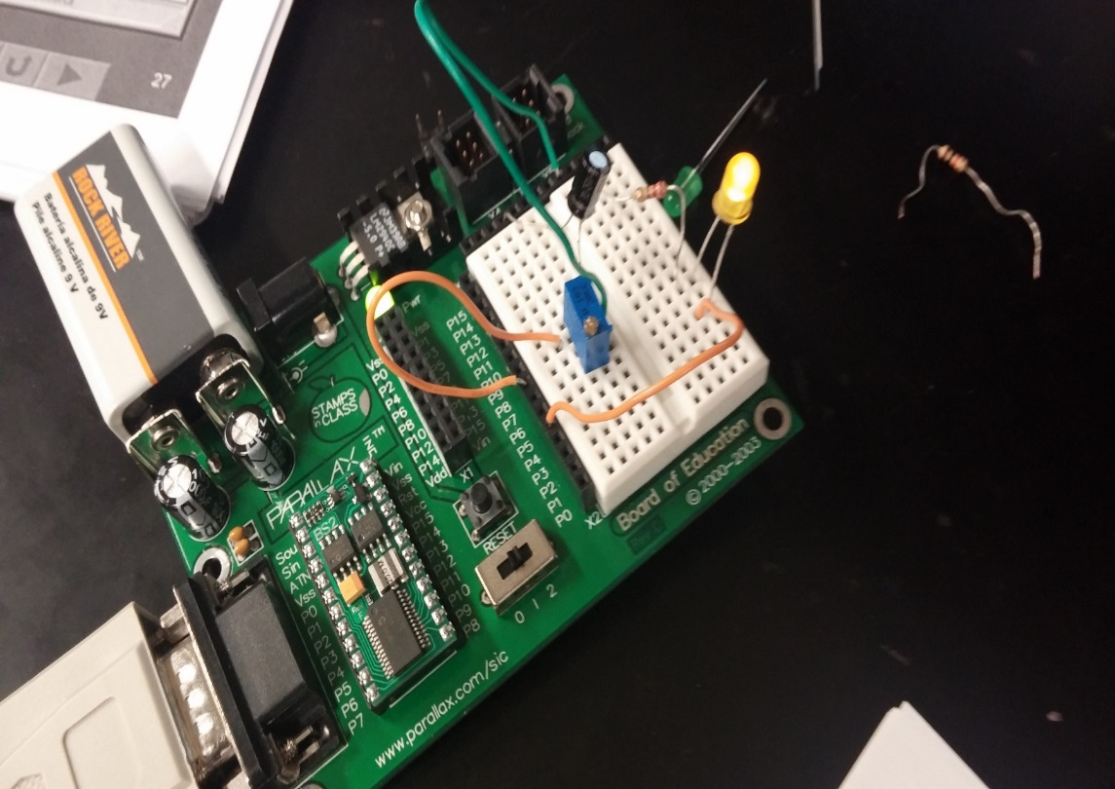
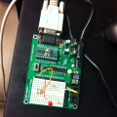
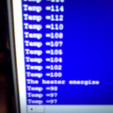
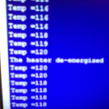
Basic stamp using variable resistor
LED ON when energized
LED OFF when de-energized

